Slide 1
Group 18 Mid-Year Progress
Louis Chuo & Henry An
Supervisors: Jesin James & Josh Bensemann

Slide 2
Project Summary
Commercial ASR
MER Calculation
Commercial Results
NZ English Datasets
Compare
Finetuned ASR
MER Calculation
Finetuned Results

Slide 3
Research Objectives
Research on any current open-source Speech Recognition projects that we can use to build upon
Determine how the NZ English accent is performing on currently available systems
Find current results on different projects for our results to compare upon
Research on current methods for how ASRs are interpreting accents
Research on other methods of quantifying accents that may have not been implemented on current ASRs
Determine the best suited method for quantifying the errors due to accented speech

Slide 4
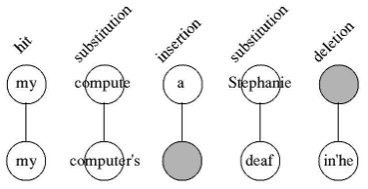
Defining Word Errors
Broken down into word “hits” (H) and errors (S, D, I)
Hits (H) = matched words
Substitutions (S) = words that are replaced
Deletions (D) = words that were removed
Insertions (I) = words that have been added
N is the total number of words in the ground truth
Figure: Breaking down how Word Error Rate is matched between the result and ground truth.^{[1]}
1. Morris, Andrew Cameron, Viktoria Maier, and Phil Green. "From WER and RIL to MER and WIL: improved evaluation measures for connected speech recognition." In Eighth International Conference on Spoken Language Processing. 2004.

Slide 5

Word Error Rate
Result: “let's flicking is the last remaining fuel drain from the generator”
Baseline: “Lights flickered as the last remaining fuel drained from the generator”
N = 11, S = 4, D = 0, I = 0, WER = 4/11 = 0.3636
Result: “the fox go to Thomas Arvada and the great”
Baseline: “The Vlachs called it Tomisovara and the Greeks called it Panglicara”
N = 11, S = 5, I = 1, D = 3, WER = 9/11 = 0.8181

Slide 6
Word Error Rate
Main Problem:
Result: “Mark as he lies in. Whiston around it.”
Baseline: “Markazi lies in western Iran”
N = 5, S = 3, I = 3, D = 0, WER = 6/5 = 1.2
Result: “Avenger bro bro”
Baseline: “Avengebrol Avencebrol Avicebrol and finally Avicebron”
N = 6, S = 3, I = 0, D = 3, WER = 6/6 = 1

Slide 7

Match Error Rate
Hypothesis: “Mark as he lies in. Whiston around it.”
Baseline: “Markazi lies in western Iran”
H = 2, S = 3, I = 3, D = 0, MER = 1 - 2/(2 + 3 + 3) = 0.75 vs WER = 1.2
Hypothesis: “Avenger bro bro”
Baseline: “Avengebrol Avencebrol Avicebrol and finally Avicebron”
H = 0, S = 3, I = 0, D = 3, MER = 1 - 0/6 = 1 vs WER = 1

Slide 8
Match Error Rate
Hypothesis: “let's flicking is the last remaining fuel drain from the generator”
Baseline: “Lights flickered as the last remaining fuel drained from the generator”
N = 11,H = 7, S = 4, D = 0, I = 0
WER = 4/11 = 0.3636
MER = 1 - 7/(7 + 4) = 0.3636

Slide 9


Word Information Lost
Derived from the Relative Information Lost measure as a statistical means to derive the “information” of the word
Can be simplified granted that the number of hits is bigger than errors
Can be considered more accurate than the other two, but more computationally expensive
Example:
Hypothesis: “let's flicking is the last remaining fuel drain from the generator”
Baseline: “Lights flickered as the last remaining fuel drained from the generator”
(N1 is number of words on baseline, N2 is number of words on hypothesis)
N1 = 11, N2 = 11, H = 7, WIL = 1 - (7/11)(7/11) = 0.595

Slide 10
Analysing ASR Performance
WIL and MER looks to better represent edge cases vs WER
MER is less computationally expensive than WIL
MER is similar in value with WER for non-edge cases
We will use MER as our main measuring technique
MER and WIL are still calculated for comparison

Slide 11




Commercial ASR Testing
Main programming language: Python
IDE: Visual Studio Code, Pycharm
Python packages: pandas, seaborn, jiwer, pydub
Pandas: data processing and extraction
Seaborn: graph plotting
Jiwer: WER, MER, WIL calculations
Pydub: converts mp3 files to wav files

Slide 12
Corpora Properties
Database Name | Is Open Source? | Number of Lines | Average Sentence Word Length | Metadata | File Type | Sentence Type | Baseline Format
JL Corpus | Yes | 2,400 | 5.39 | Emotion, Gender | .wav | Set of sentences, repeated per emotion | Separate text files
Mozilla Common Voice | Yes | 4,366 | 10.411 | Gender, Age, Accent | .mp3 | Unique sentences sampled from internet | CSV
Mansfield Corpus | No | 1,863 | 9.78 | 2 Females, 2 Males | .wav | Unique sentences from NZ literature | CSV

Slide 13
Commercial ASR Testing
Commercial ASR | Free Credits | Pricing | Has NZ Model | Local File Support | Native mp3 file support
Microsoft Azure Speech-to-text | US $200 | $1 per hour | Yes | Yes | No
Google Speech-to-text | US $300 | $0.006 per 15 seconds | Yes | Yes | Yes
Amazon Web Services Transcribe | None | $0.024 per minute | Yes | No | Yes

Slide 14
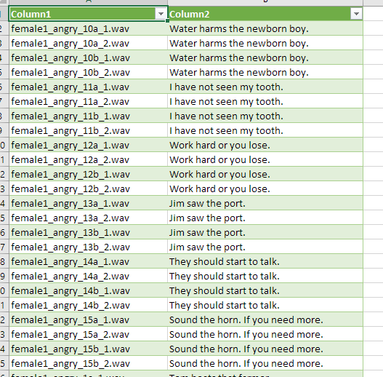
Commercial ASR Testing for Microsoft and Google
All Corpus files are located within their respective folders
Files looped through, fed into function
Function makes API calls to google/microsoft
Outputs the result of ASR as a string
Saved in excel files for later processing

Slide 15
if __name__ == "__main__":
os.environ['GOOGLE_APPLICATION_CREDENTIALS'] = 'service.json'
name_array = []
result_array = []
x = 0
for filename in os.listdir("speech/Mansfield"):
if filename.endswith(".wav"):
file_path = "speech/Mansfield/" + filename
translated_result = transcribe_file(file_path)
print(file_path)
print(translated_result)
name_array.append(filename)
result_array.append(translated_result)
with open('speech/Mansfield_output_google_NZ.csv', 'w', newline= '') as out_file:
tsv_writer = csv.writer(out_file)
while x < len(name_array) :
tsv_writer.writerow([name_array[x], result_array[x]])
x += 1

Slide 16

Commercial ASR Testing for Amazon
Upload wav file onto cloud
Read file names from local directory
Loop over files and create transcribe jobs
Download finished transcriptions with same name into named folder
Transcriptions are matched with their truth values by the name of the file

Slide 17
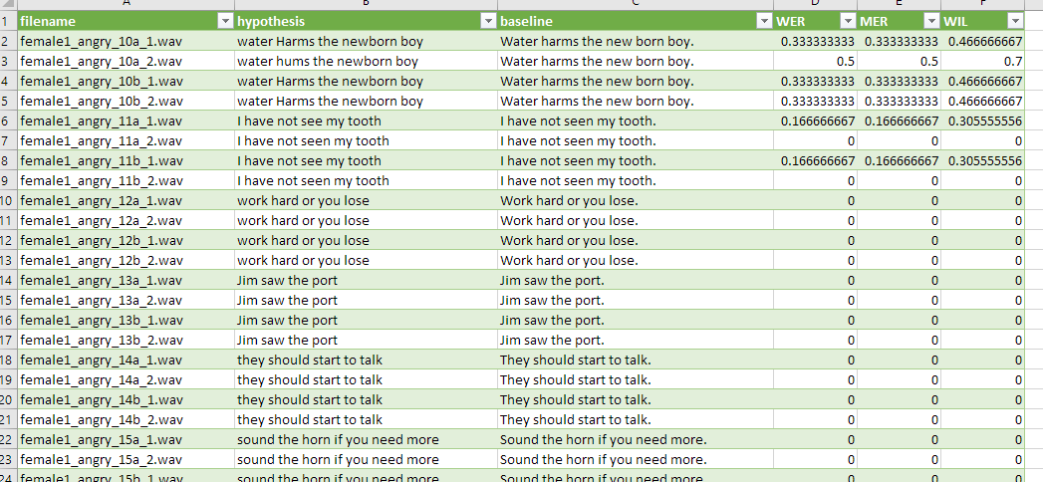
MER Calculation
Loops through ASR results
Matches filenames to the baseline
Extracts info then use jiwer for calculations
Saved in excel files for plot graphing
The asr and baseline results also saved for reference

Slide 18
for i in range(len(result_file_names)):
for j in range(len(control_file_names)):
if ((control_file_names[j] + ".wav") == result_file_names[i]):
control_match_array.append(control_contents[j])
if (isinstance(result_contents[i], str)):
measures = jiwer.compute_measures(control_match_array[i], result_contents[i], truth_transform=wer_preprocess, hypothesis_transform=wer_preprocess)
wer = measures['wer']
mer = measures['mer']
wil = measures['wil']
WER_array.append(wer)
MER_array.append(mer)
WIL_array.append(wil)
else:
WER_array.append(5)
MER_array.append(5)
WIL_array.append(5)
x = 0
with open('speech/Measurement Results/Mansfield_measures_speechbrain.csv', 'w', newline= '') as out_file:
tsv_writer = csv.writer(out_file)
while x < len(result_file_names) :
tsv_writer.writerow([result_file_names[x], result_contents[x], control_match_array[x], WER_array[x], MER_array[x], WIL_array[x]])
x += 1

Slide 19
Commercial ASR Testing
Each call made was 2 to 3 seconds on average
To process whole corpora:
2400 + 4366 + 1863 = 8629 x 3 = 25,887 seconds or 7.2 hours
Models processed: Google NZ & US, Microsoft NZ & US
Total time for processing: ~ 29 hours

Slide 20
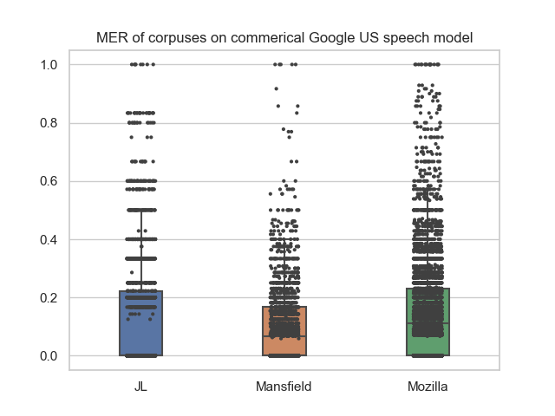
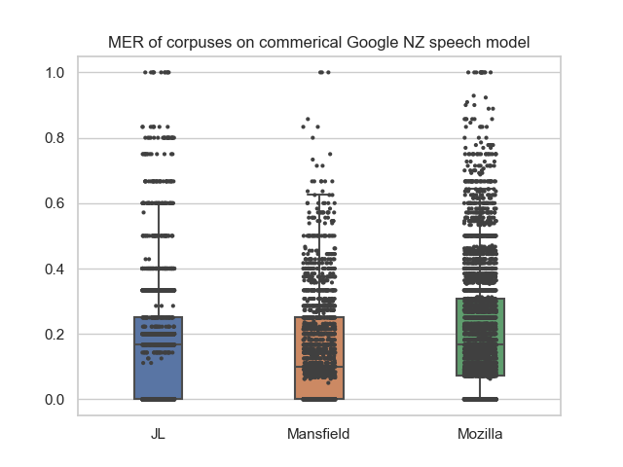
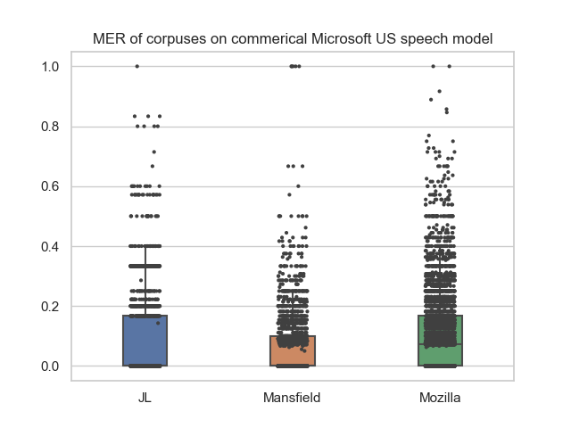
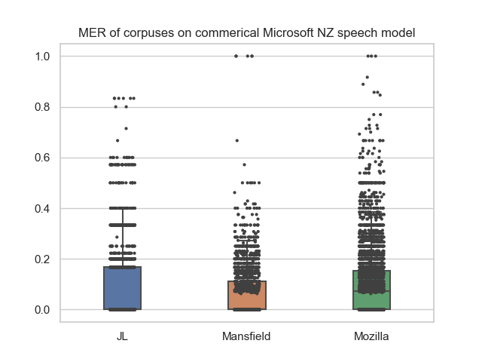

Slide 21
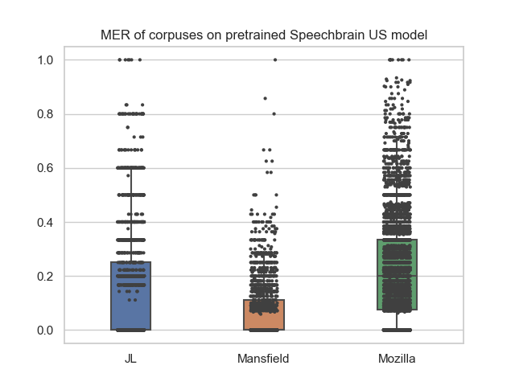

Slide 22
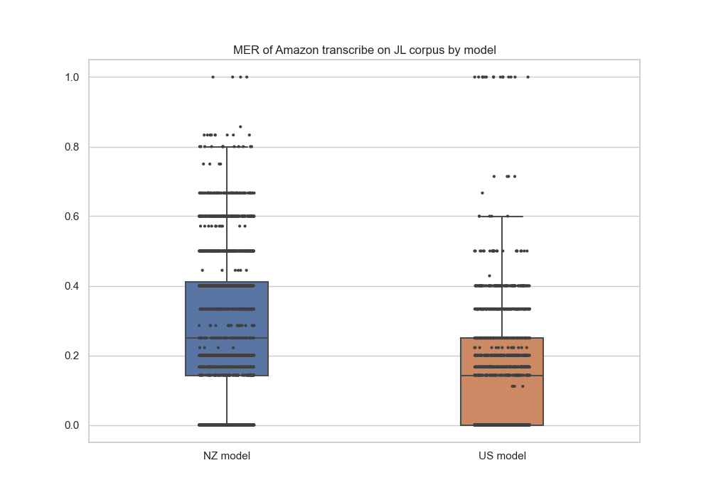

Slide 23
Tentative Results
All of the results are for NZ english
The New Zealand model of google performs worse than the US model on NZ English Why?
The NZ model could be less refined, less resources spent on training
THe NZ model could be outdated, less priority for training

Slide 24
Conclusion
NZ English ASR Models exist for major Commercial systems
However the performance of these models is lacking

Slide 25
Next Steps
Working on open source ASR Systems
Speech Brain
Vosk
Fairseq
Ultimately - Creating/Modifying a model for NZ English, likely based on one of these systems

